Slide 1
The Canterbury Tales
Geoffrey Chaucer
English 12

Slide 2
Doodle Notes
Rules:
When you see a slide with a title that is in YELLOW FONT- you must take your doodle notes!
Represent the concepts in each slide with DOODLES/DRAWINGS, and label with a FEW WORDS/NUMBERS (as needed)
No COLOR necessary
NUMBER EACH SECTION AS YOU GO (YOU SHOULD END UP WITH DRAWINGS TO REPRESENT 9 SLIDES)

Slide 3
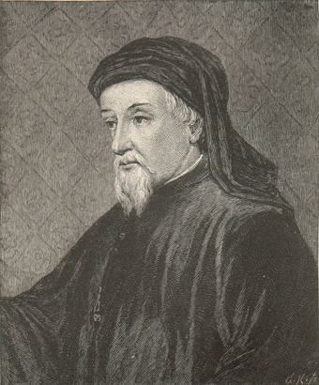
Geoffrey Chaucer: Early Life
Born c. 1340
Son of a prosperous wine merchant (not nobility!)
In his mid-teens, he was placed in the service of the Countess of Ulster
  More education
  Schooled in court and society life
  Learned Latin
  Some Greek
  Perhaps some French and Italian

Slide 4
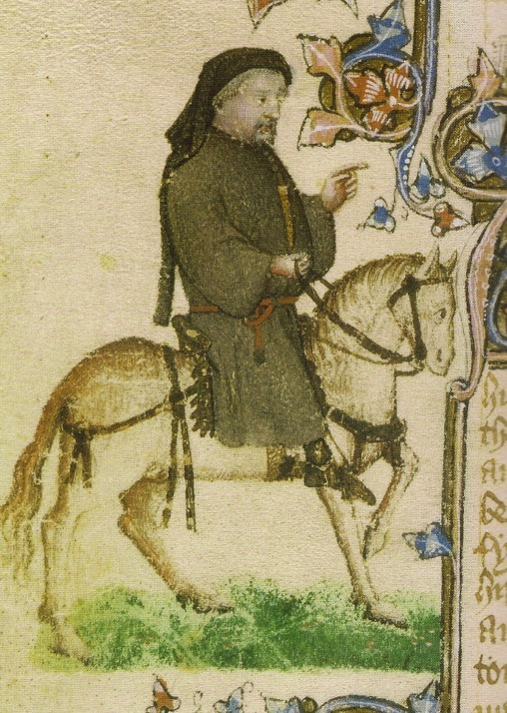
Early Life continued…
Served in the English Army
  1359 Captured by the French during the Hundred Years’ War
  Ransomed by King Edward III a year later
  Married Philippa of Hainault, a lady-in-waiting to Edward III's queen
Chaucer joined the royal household
  Became a trusted messenger
  Studied law/ began writing
Notes:
The Hundred Years' War is the modern term for a series of conflicts waged from 1337 to 1453 by the House of Plantagenet, rulers of the Kingdom of England, against the House of Valois, rulers of the Kingdom of France, for control of the Kingdom of France. Each side drew many allies into the war. It was one of the most notable conflicts of the Middle Ages, in which five generations of kings from two rival dynasties fought for the throne of the largest kingdom in Western Europe. The war marked both the height of chivalry and its subsequent decline, and the development of strong national identities in both countries.
Edward III (13 November 1312 – 21 June 1377) was King of England from 25 January 1327 until his death; he is noted for his military success and for restoring royal authority after the disastrous and unorthodox reign of his father, Edward II.

Slide 5
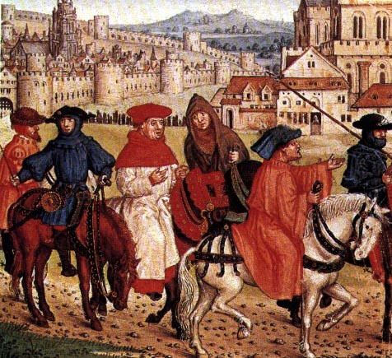
The Canterbury Tales
Chaucer writes about a group of people going on a pilgrimage.
TIME TO CHAT:
Have you even been on a pilgrimage?
Have you ever known someone that has been on a pilgrimage?
Notes:
A journey to a sacred place or shrine. 2. A long journey or search, especially one of exalted purpose or moral significance.

Slide 6
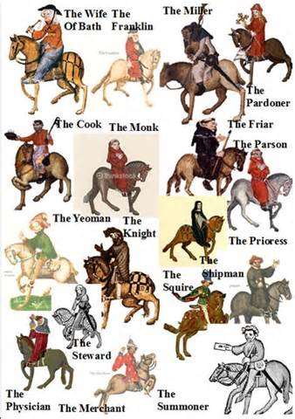
The Canterbury Tales
Chaucer described his characters by:
  Their job
  The type and color of their clothing
  Their “accessories” (jewelry, pets, other objects)
  The way they act
  Their income
  Their “secrets”
  Their status in society as a whole
  The way they speak/their slang or accent
  Their mode of transportation

Slide 7
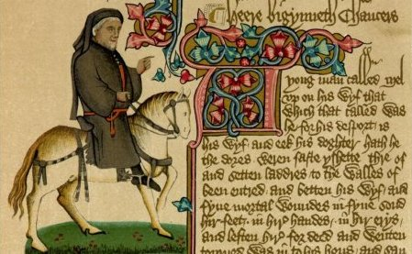
Chaucer’s Plan
A prologue (introduction) followed by a series of stories and linking dialogues and commentaries
Each character would tell two stories going and two stories coming home
  --uh… coming home from WHERE?
Canterbury, of course. After all, his work IS called: The Canterbury Tales

Slide 8
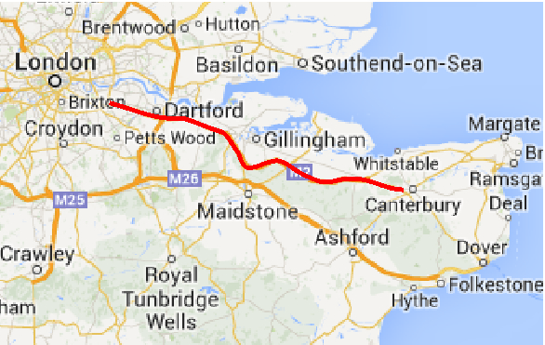
Map

Slide 9
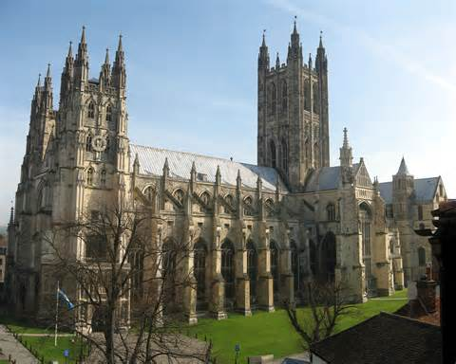
But why go to Canterbury?

Slide 10
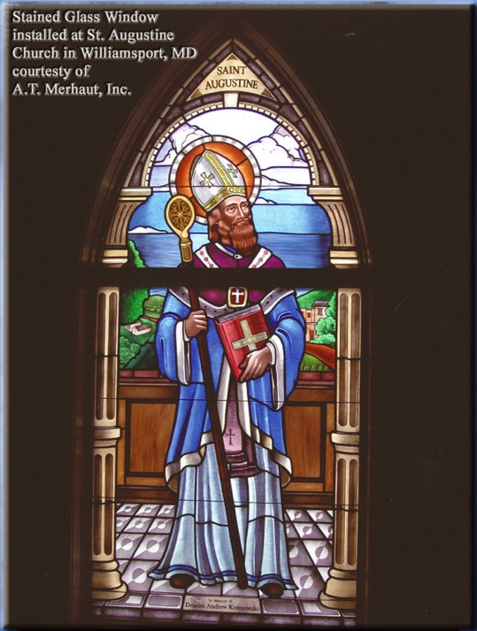
One answer: Religion
Canterbury has always been an important religious center in England.
St. Augustine (seen in stained glass from the Canterbury Cathedral) was sent by Pope Gregory the Great to establish the Catholic faith in the country
Religion played an important part in medieval life.

Slide 11
Why was religion important?
It’s the Middle Ages
  Plague
  Warfare
  High infant mortality rate
  Short life expectancy
    …and if you were a peasant, you lived your whole life in harsh conditions
  About the best thing that you had to look forward to was dying and going to heaven

Slide 12
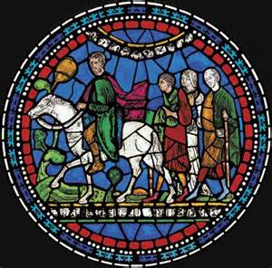
Also, Canterbury was a Pilgrimage Site
People of all classes went on pilgrimages to holy sites to ask for help with medical, financial, or other problems.

Slide 13
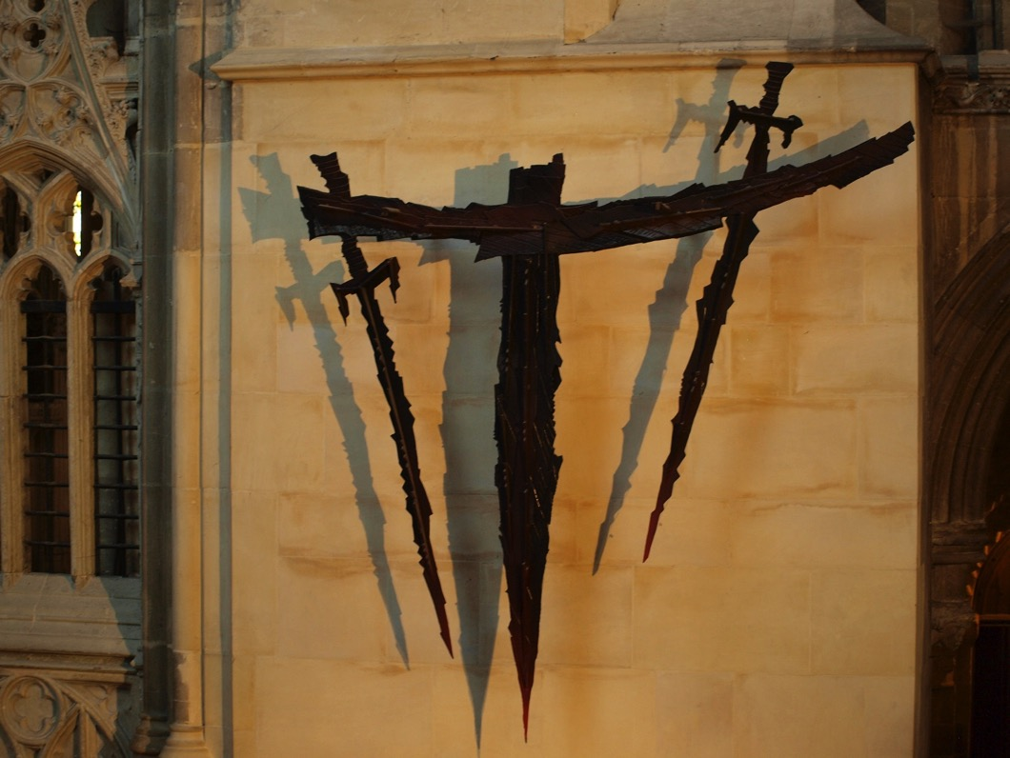
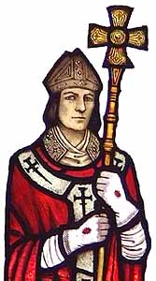
The Shrine of St. Thomas à Becket

Slide 14
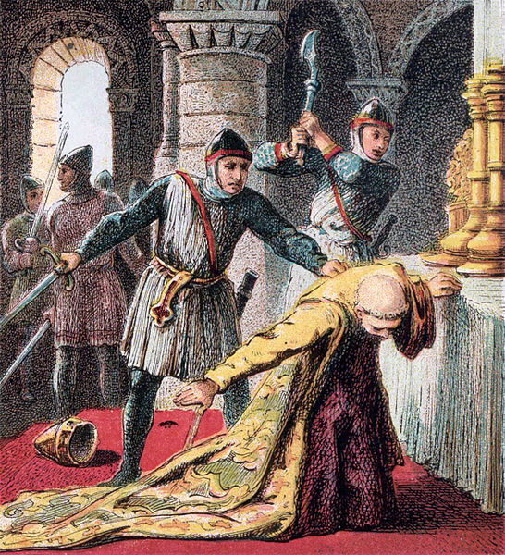
St. Thomas à Becket
Becket was a trusted adviser and friend of King Henry II.
Henry named Becket to be the Archbishop of Canterbury
However, … Becket’s outspoken style angered the King.
  One day, Henry complained, “Will no one rid me of this meddlesome priest?”
  Three knights rode to Canterbury where they found Becket at the altar of Canterbury Cathedral.
  Becket was murdered at the altar.
  The death of Becket angered the peasants who felt his Saxon heritage made him one of them.
  Canterbury Cathedral, thus, became a site for pilgrims to offer prayers to St. Thomas.
  Today, a modern cross made from swords marks the site of martyrdom.

Slide 15
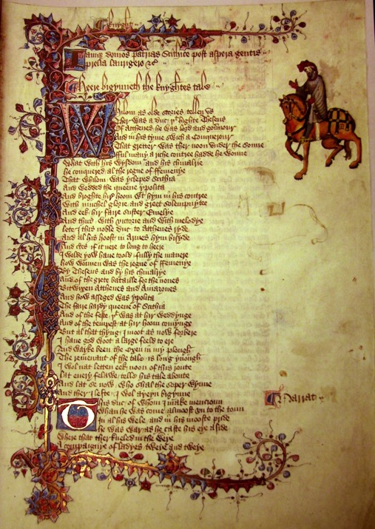
Middle English
Chaucer wrote in Middle English (rather than French or Latin like many of his fellow writers), because ordinary folk could enjoy The Canterbury Tales and its vivid characters.

Slide 16
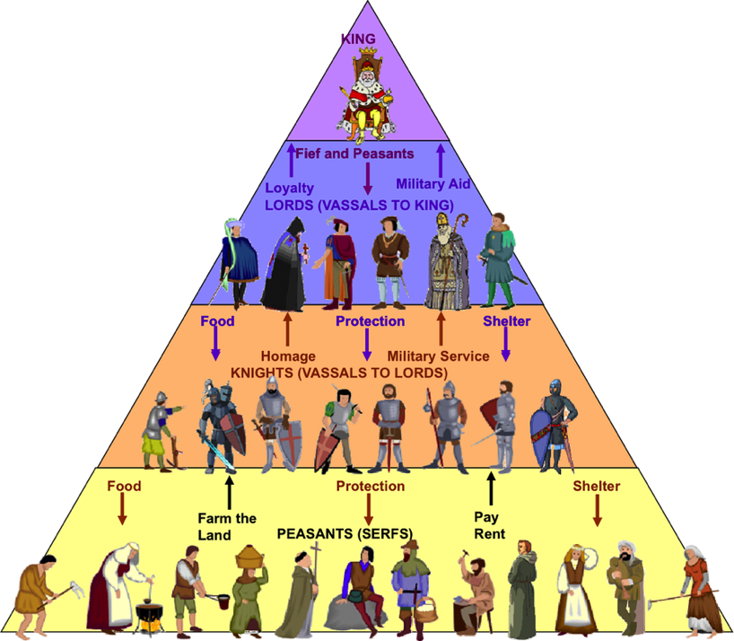
The Feudal System

Slide 17
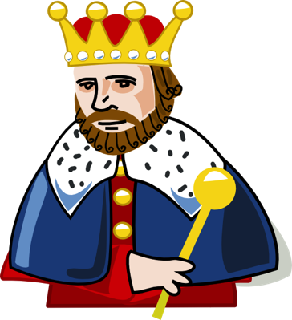
The King
Owned all the land
Could choose to GRANT land to his supporters
Supporters had to swear an oath of loyalty to the King.

Slide 18
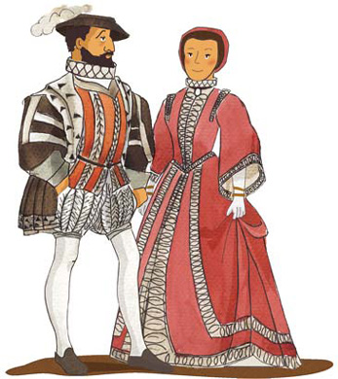
Barons
Barons leased land from the King (which was known as a manor). They were known as the Lord of the Manor and were in complete control of this land. They established their own system of justice, minted their own money and set their own taxes.
Had to provide the King with:
  Knights
  Money
  Advice
  A place to stay while traveling

Slide 19
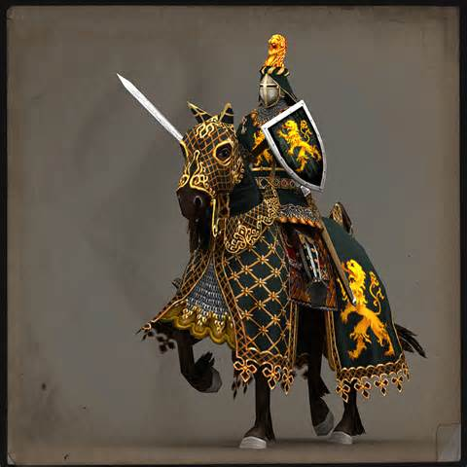
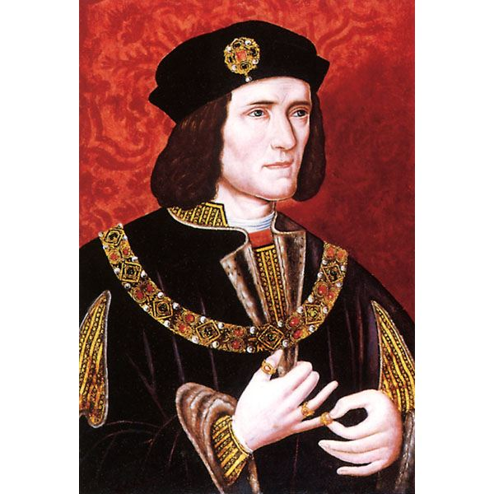
Knights
Knights were given land by a Baron in return for military service when demanded by the King.
They also had to protect the Baron and his family, as well as the Manor, from attack.
The Knights kept as much of the land as they wished for their own personal use and distributed the rest to serfs.
Although not as rich as the Barons, Knights were quite wealthy.

Slide 20
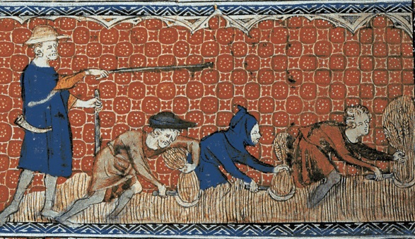
Serfs
They had to provide the Knight with free labor, food and service whenever it was demanded.
Serfs had no rights.
They were not allowed to leave the Manor and had to ask their Lord's permission before they could marry.
Serfs were poor.
Notes:
https://en.wikipedia.org/wiki/Sark

Slide 21
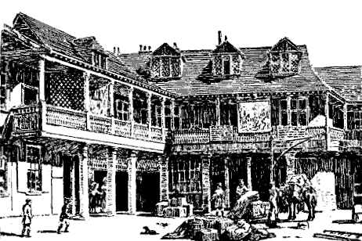
So, let’s travel back to London, to the area called Southward, and start at the Tabard Inn…

Slide 22
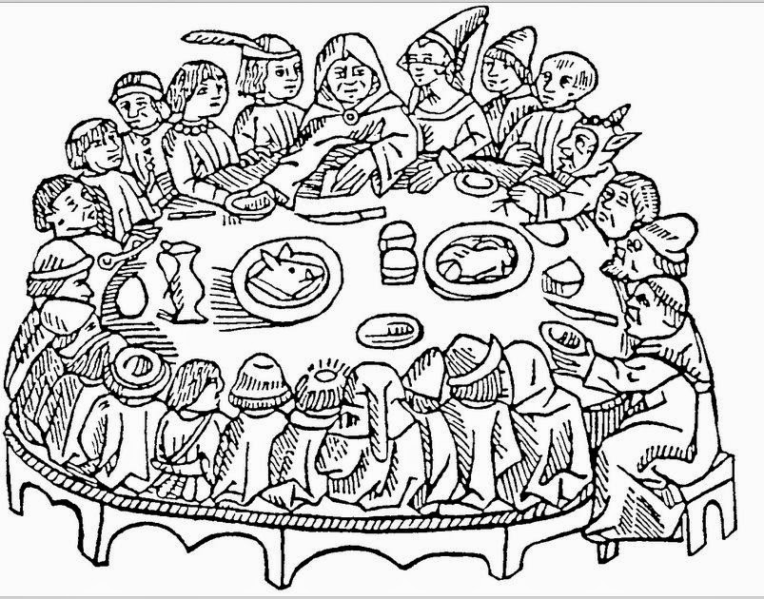
Where we meet the Innkeeper, our host

Slide 23
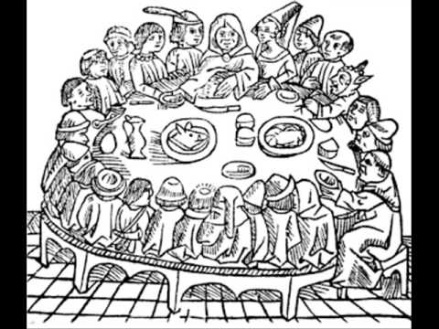
And then we meet the characters and hear their stories.

